Slide 1
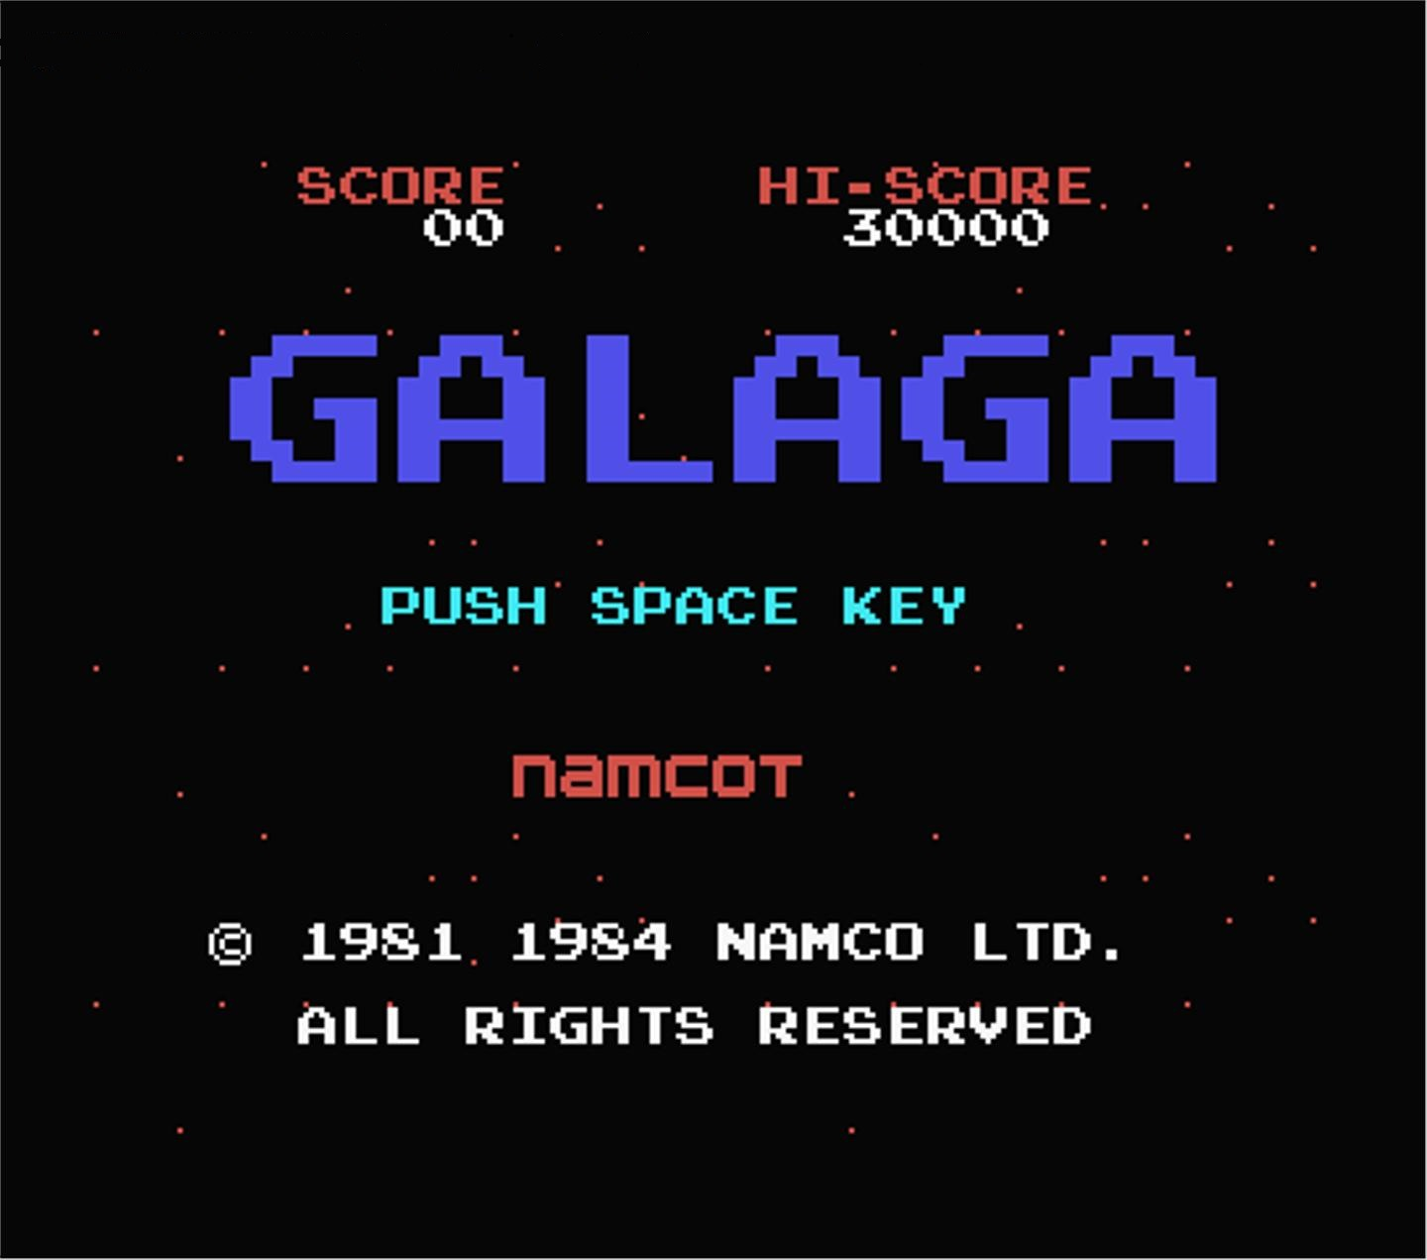
REMADE FOREVER
Brandon goh nian zhou – 121309D
Kho liang hao – 121320s
Ron ng jian yian - 120160y
Sim yuan he - 122816d

Slide 2



Menu UI
I wonder what is to be written here…
Maybe someone can fill me in?

Slide 3
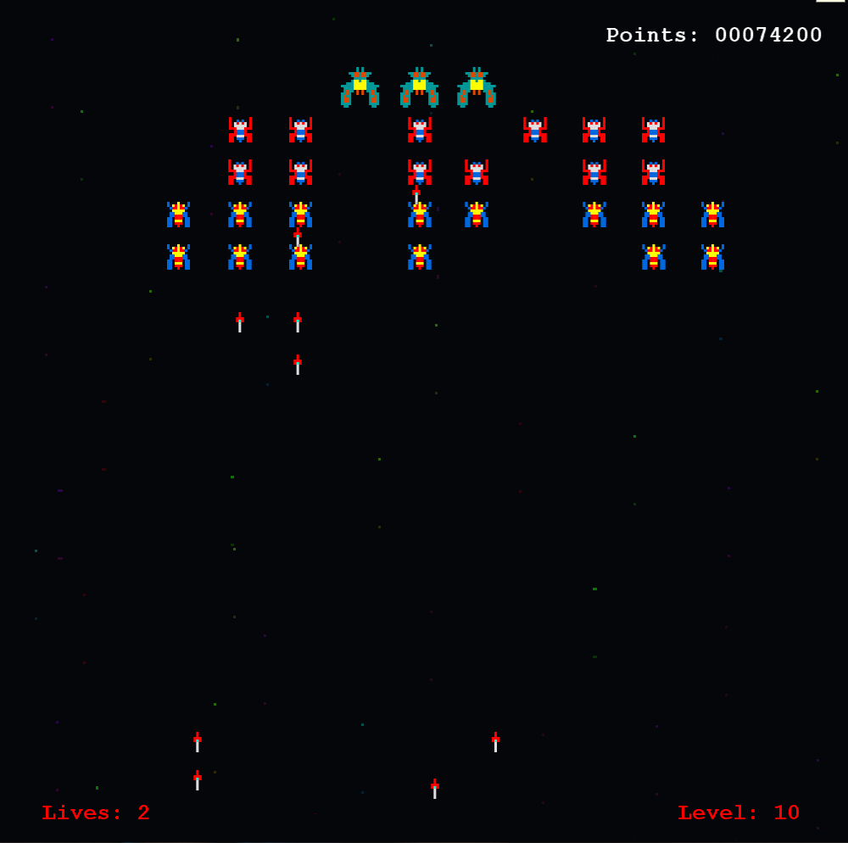
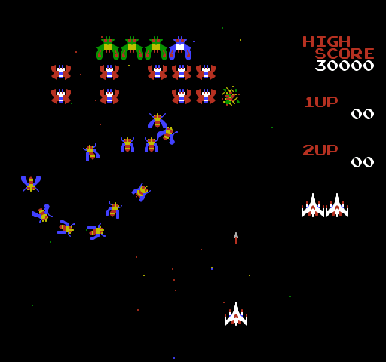
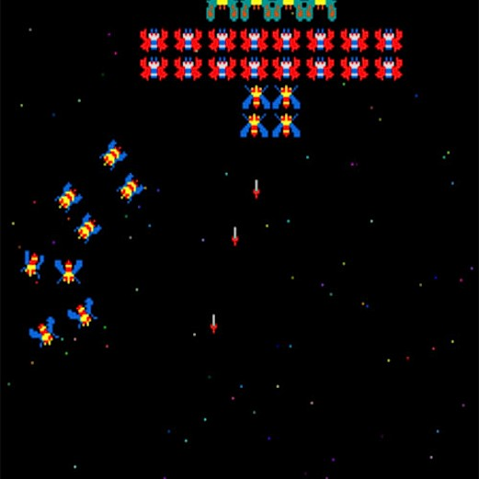
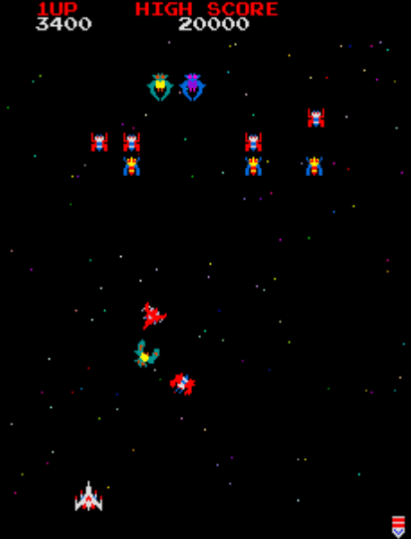
Gameplay
Here’s where the fun part comes in
Say stuff like particles, enemy ships, player ship, high score, asteroids, bullets, missiles

Slide 4
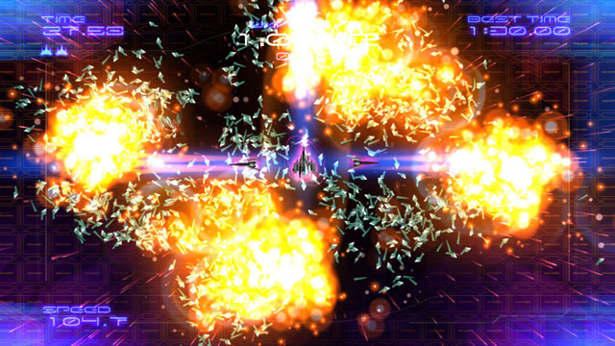
Game over
I’m guessing what’s going to happen here is that when the player ship gets hit, YOLO.

Slide 5
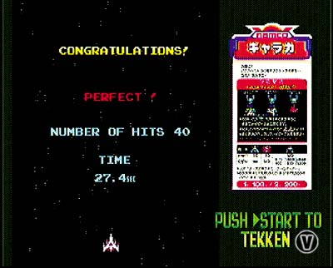
SHOP UPGRADE
Well the upgrades are purchasable after each game so . . .

